Slide 1
Housing Finance Forum ―
Sustainable Housing in International Finance
June 2026
International Affairs Group
International Affairs and Research Department
Japan Housing Finance Agency

Slide 2
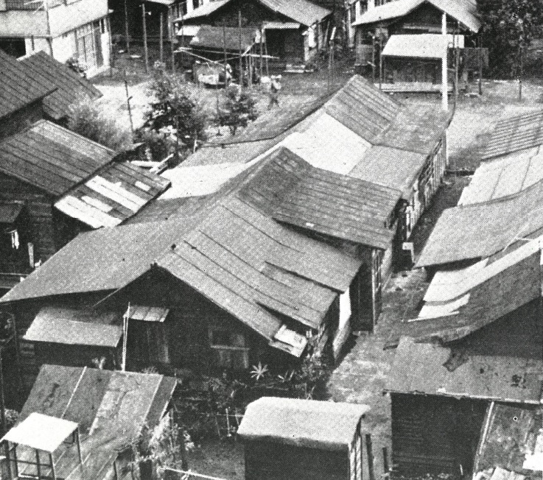
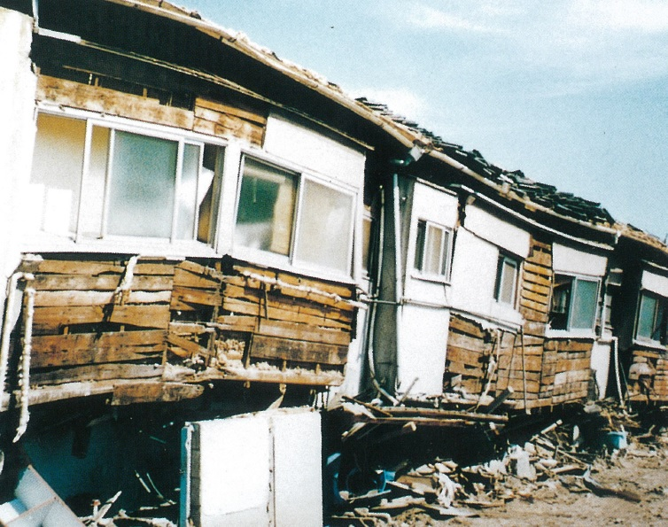
1. Development of Housing Performance Standards in Japan
Introduction of Housing Performance Standard
The Housing Performance Standard in Japan refers to a set of regulations and guidelines designed to ensure the quality, safety, and sustainability of residential buildings
These standards were introduced to promote high-quality housing, improve residential safety, and address issues such as disaster resilience, energy efficiency, and environmental sustainability
1945 -1950s
1960s – 1990s
2000 - Present
After the WWII, Japan faced a severe housing shortage
Lack of standardized housing performance criteria hindered safety, durability, and comfort
Rapid economic growth and urbanization increased the demand for better housing
The Great Hanshin-Awaji Earthquake (1995) revealed vulnerabilities against earthquakes
Housing Quality Assurance Act (HQAA) was introduced to achieve higher-quality housing
HQAA established Housing Performance Indication System, a standardized framework for evaluating housing performance
The System was expanded to include existing homes in 2002

Slide 3
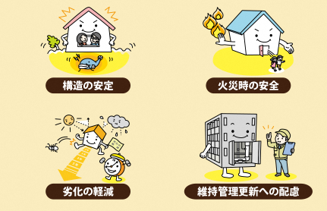
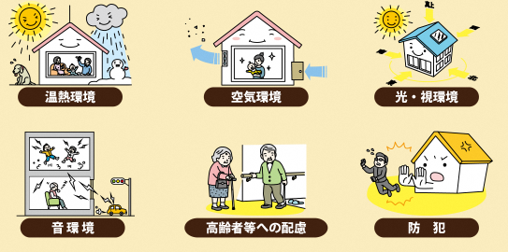
1. Development of Housing Performance Standards in Japan
Effective since April 1, 2000
The aim of Housing Performance Indication System was to establish a housing market in which individuals can confidently purchase high-quality housing
Although the System is voluntary, many developers and builders participate to demonstrate the quality of their housing and gain a competitive advantage in the market
10 key evaluation criteria of measuring housing performance
Structural stability
Safety during fire
Thermal environment
Air quality
Light and visual environment
Reduction of deterioration
Consideration of maintenance
Acoustic environment
Consideration for the elderlies
Security measures
Source: The Association for Evaluating and Labeling Housing Performance

Slide 4
1. Development of Housing Performance Standards in Japan
Third party evaluation
Housing performance is assessed by registered third-party evaluation organizations certified by the Ministry of Land, Infrastructure, Transport and Tourism (MLIT)
This ensures transparency and impartiality in the evaluation process
Housing Performance Evaluation Report
Homes that meet the standards are issued a Housing Performance Evaluation Report, which can be used during transactions such as sales or purchases to provide assurance to buyers
Benefit of receiving the Housing Performance Evaluation Report
Homeowners holding the Report are qualified to apply for dispute resolution through the Designated Housing Dispute Resolution Body, a local bar association
The Designated Housing Dispute Resolution Body will handle the case to achieve resolution
Homeowners holding the Report are eligible for discounts on earthquake insurance premiums
Seismic Isolation Building Discount |  | 50% discount applicable
Seismic Grade Discounts (Prevention of Structural Collapse) | Seismic Grade 3 | 50% discount applicable
 | Seismic Grade 2 | 30% discount applicable
 | Seismic Grade 1 | 10% discount applicable
Source: The Association for Evaluating and Labeling Housing Performance

Slide 5
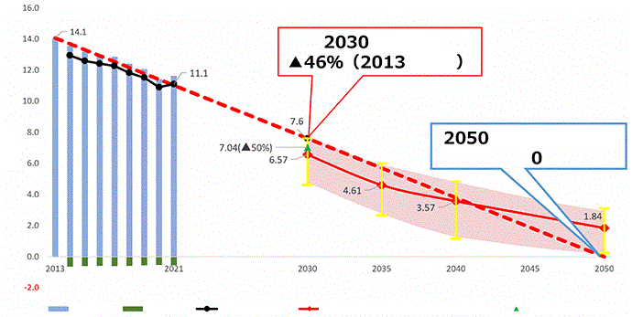
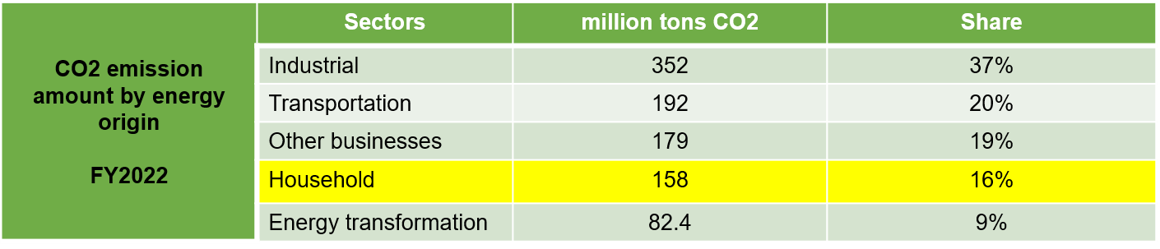
2. Green housing finance initiatives by JHF
Japanese Government’s CO2 reduction scenario by 2050
target
from 2013
00 million tons of CO2
net emission
target is
Emission
Absorption
Net emission
Process to achieve max +1.5 degrees scenario under IPCC report
50% reduction from 2013
Source: Ministry of Economy, Trade and Industry

Slide 6
2. Green housing finance initiatives by JHF
MLIT GX initiatives to promote decarbonization in housing and buildings
Promoting energy efficiency and CO2 reduction in housing and buildings
・ Based on the Building Energy Efficiency Act (revised in June 2022), compliance with energy-saving standards will be made mandatory for all new residential and non-residential buildings starting in fiscal year 2025
・ In collaboration with relevant ministries, support will be provided for the promotion of Net Zero Energy House (ZEH) and Net Zero Energy Building (ZEB), as well as energy-efficient renovations
・ Efforts will be made to promote CO2 reduction throughout the entire lifecycle of buildings
Before the Act revision
Floor size | Non-residential | Residential
> 2,000 m² | Mandatory | Report
Mid size | Mandatory | Report
300 m² > | Explanatory | Explanatory
After the Act revision
Floor size | Non-residential | Residential
> 2,000 m² | Mandatory | Mandatory
Mid size | Mandatory | Mandatory
300 m² > | Mandatory | Mandatory
Promoting the use of wood in housing and buildings
・ Measures will be implemented to rationalize building standards and provide support for high-quality medium- to large-scale wooden buildings
JHF’s Flat 35 and JHF’s Green labeled Flat 35 Mortgage applicable after April 2025
Thermal insulation performance | Grade 1 | Grade 2 | Grade 3 | Grade 4 | Grade 5 | Grade 6 | Grade 7
Primary energy consumption amount performance | Grade 1 | N/A | Grade 3 | Grade 4 | Grade 5 | Grade 6
Energy efficiency standard
Green labeled Flat 35
Source: Ministry of Land, Infrastructure, Transportation and Tourism (MLIT)

Slide 7


2. Green housing finance initiatives by JHF
Fulfillment of the four core components under Green Bond Principal
1. Use of proceeds
Use of proceeds is stated in the
explanatory materials for investors
Use of proceeds falls into the
category of “energy efficiency” as
exemplified in GBP
Flat 35 S (ZEH) |  | Flat 35 S (Energy efficiency)
Flat 35 Renovation (Energy efficiency) |  | Flat 35 Renovation (Durability/modifiability)
2. Process for
projection
evaluation and
selection
One of the goals of the “Basic Housing Plan” (Cabinet decision on March 19, 2021) is to “improve housing circulation systems toward a decarbonized society by construction and the formation of high-quality housing stock.” JHF, as a policy implementation agency, responds to the policy issues by providing a variety of financial services
The energy conservation standards for Flat 35, which is eligible for green bonds, are set pursuant to laws and regulations
3. Management of
proceeds
The full amount of proceeds are promptly applied to the purchase of Flat 35
JHF annually confirm that the outstanding balance of green bonds is within the range of Flat 35 outstanding balances which are eligible for green bonds
4. Reporting
JHF carries out reporting on the allocation status of green bonds and impact reporting on environmental improvement effects to the extent practicable
Source: ICMA

Slide 8
2. Green housing finance initiatives by JHF
Impact reporting on green bonds
Environmental Improvement Benefits (as of the end of FY2024)
7,147 tons/year
＝ Estimated CO2 reductions effect by Green Bonds issued in FY2024 (*)
(*) Number of loans in proportion to the amount of Green Bond issuance × CO2 emission reduction compared to "Current average energy efficiency performance of housing“
Reference: Energy efficiency performance standard and CO2 emissions by types of Flat 35
Classification | Standard | CO2 emissions (Single detached houses) | CO2 emissions (Condos)
Current average energy efficiency performance of housing | Thermal insulation Performance Grade 4 and Primary Energy Consumption Amount Grade 4 | 3,675 kg (“Case1”) | 2,862 kg (“Case2”)
Flat 35 S ZEH* | “ZEH” standard defined by the “ZEH Roadmap Committee” | Reduction amount from Case1 is ▲2,731 kg | Reduction amount from Case2 is ▲2,130 kg
Flat 35 S (Interest Plan A) energy efficiency | Thermal insulation Performance Grade 5 and Primary Energy Consumption Amount Grade 6 | Reduction amount from Case1 is ▲547 kg | Reduction amount from Case2 is ▲427 kg
Flat 35 S (Interest Plan A) durability and flexibility | Long-term Quality Housing Thermal insulation Performance Grade 5 and Primary Energy Consumption Amount Grade 6 | Reduction amount from Case1 is ▲547 kg | Reduction amount from Case2 is ▲427 kg
* Zero Emission House refers to a residential building designed to achieve net-zero energy consumption annually by improving energy efficiency and incorporating renewable energy sources.
Source: ICMA

Slide 9
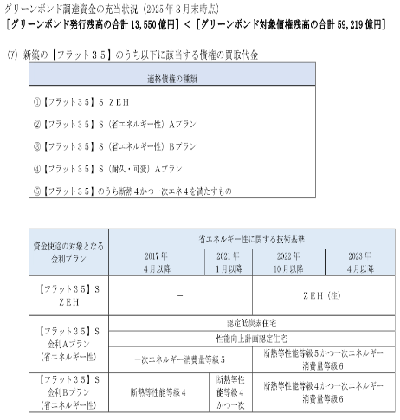
3. Issuance of JHF Green MBS and Green Bond
Key features
Green labeling
Asset
Liability
Green
JHF Green MBS
＋
Green Bonds
Flat 35
Non-green
JHF MBS
＋
Straight bonds
Compliance
and
Second Party Opinion (“SPO”)
MoE Framework compliance?
Yes
ICMA Green Bond Principle compliance?
Yes
SPO from the rating agencies?
Yes
Current disclosure
of
Green Bond
Page 25 of FY2024 JHF Issuer Information
Q1 Where is the green related information disclosed?
A1 On issuer Information.
Q2 What kind of information is provided?
A2 Main information is the “Use of proceed issuing Green
Bonds”, which is categorized as below.
- Current status of the allocated proceeds
As of March 31, 2005
(i) GB outstanding 1,355.0 billion JPY
(ii) Green loan outstanding 5,921.9 billion JPY
(i) < (ii) indicates safeness from green washing
- Improvement effect to the environment
9

Slide 10
4. Energy efficiency framework － Compulsory or voluntary
 | Compulsory – Japan Case | Voluntary
Environment impact | Nation wide impact | Impact on individual construction project
 | Large scale energy-efficiency improvement | Small scale energy-efficiency improvement
Fee payable by the owner to receive green certificate | Upfront inspection fee
 | No green certificate maintenance fee | Green certificate maintenance fee
Green certificate authenticator and efficacy | Government acknowledged inspection agencies | Certificate specialists
 | No certificate means no construction | No certificate means no green
Achievable sustainability goals | Energy efficiency
 | N/A | Water conservation, materials, indoor air quality, site sustainability and others
Implication to affordable housing
Compulsory framework ensures consistency and uniformity across the housing sector, which is critical for achieving national energy efficiency and sustainability goals
Compulsory framework is a bottom up approach that allows the society as a whole to capture the opportunity to live in a better living environment and improve their living conditions
Compulsory framework requires government initiative and cost sharing. Private certification can be costly, as certification is a commercial activity

Slide 11
5. Defining Green and Non-Green Boundaries Using the BESTGER Standard
Requirements
ALL THREE criteria must be fulfilled
1. Comprehensive Evaluation: BESTGER “Silver (50 points or more)”
2. Heating Energy Reduction: Achievement of “Class B (reduction rate of over 10%)” or higher
3. Guarantee of construction accuracy: Submission of technical evidence, including construction photo records obtained through Hidden Works Inspections
Max 100 points
3. Submission of technical evidence to ensure construction accuracy
Indoor Environment
12 points
Platinum 80+ points | 1. BESTGER Silver Grade or higher
Gold 65 to 79 points
Silver 50 to 64 points
Certified 40 to 49 points
Safety
15 points
Water Conservation
18 points
Materials
10 points
Energy
Efficiency
35 points
2. Heating Energy Reduction of “Class B (reduction rate of over 10%)” or higher
Environment
10 points

Slide 12
6. Best Practices for Promoting Green Housing Quality in Mongolia
■Multi-layered human resource development and establishment of a certification program
Goal
Strengthen on-site quality assurance by capacity development
Model case
Hokkaido Building Technology Association
Certification of green architects and construction managers
Certify engineers who understand BESTGER's evaluation logic
Certify engineers who can perform appropriate insulation and airtightness design and on-site management
Building Insulation Specialist approval
Professional certification and training framework designed to ensure high standards in building insulation work
Certification is awarded to those completed training and passed exams on insulation theories
Checklist-based training for field technicians
Introducing “construction standard manual” with photographs to ensure consistent quality without relying on individual skills
Further develop BESTGER practitioners
Develop skills to evaluate and refine BESTGER
Increase loan underwriters’ capability to accurately assess the consistency between BESTGER scores and construction photographs

Slide 13
6. Best Practices for Promoting Green Housing Quality in Mongolia
■Establishment of Building Material Testing Center and ensuring safeness and reliability
Goal
Develop domestic capability to verify building material performance
Model case
Foundation Building Materials Testing Center in Japan
Center focusing on testing, inspection, evaluation, and certification of building materials and construction products
The center provides certification for building materials to ensure they meet Japanese Industrial Standards (JIS), Japanese Agricultural Standards (JAS), and other regulatory requirements, thereby ensuring safety, reliability, and compliance with national standards
Establishment of Building Material Testing Center in Mongolia
Introduce Thermal Conductivity Measurement Device (Guarded Hot Plate Method/GHP, etc.) and measure the precise λ value of insulation materials
Introduce Building Component Thermal Performance (U-value) Testing Device and measure the actual heat transfer coefficient of windows and doors
Establish Steady-state and Transient Combined Heat and Moisture Transfer Measurement to evaluate the risk of internal condensation
Establishing an institution as an “independent third-party organization” separate from the government is essential

Slide 14
6. Best Practices for Promoting Green Housing Quality in Mongolia
■Promotion of domestic materials and standardization
Goal
Ensure air tightness and minimize thermal bridges
Air leakage in Mongolian
block construction is
severe
Use of “continuous airtight layers with wet plaster” is standardized
Inside wall airtight sheet installment is difficult
“Airtight plaster method” using thick interior mortar as the airtight layer and sealing floor and ceiling joints with specialized tape or sealant.
Heat loss from thermal
bridge is not properly
managed
Adhesive and plastic anchors are used to fix the insulation
Anchors can become the thermal bridge
“Recessed anchor method” requiring deep anchoring and covering of the anchor heads with caps
Proper thermal insulation
of pipe sleeves, window
sash and balconies
Not only fill around penetrating pipes with site-applied spray foam urethane, but also install an “airtight flange” on the interior side to integrate it with the airtight layer
Float window sash from the structure and install insulation, introduce “thermal connectors” to structurally separate the balcony edges

Slide 15
7. Ensuring Housing Quality Through Financial Instruments
■Offering preferential interest rate on green housing loan will promote building of quality housings
Expected outcomes of preferential interest rate applied green housing loan
Policy alignment
Access to funding
Enable financial institutions access green finance
Environmental
benefit
Reduces carbon emission, improves indoor air quality. Avoid cellular stress response
Long-term
cost savings
Lower utility bills, longer life span of the house
Market
transformation
Raise the overall quality of the housing stock
Higher standard
adaptation
Higher energy efficiency or environmental standards will increase the housing quality
Financial
incentive
Preferential interest rate lowers cost of funding

